Slide 1

Machine Learning with Big data Project Topic: Large-Scale Sentiment Analysis of Social Media Data Using Apache Spark
Github Link: https://github.com/Tirtho-69420/MLBD_Project
Goutam Bhattacharya (M25DE1029) Abhirup Ghosh (M25DE1073)

Slide 2
Project Overview
Dataset: Sentiment140 (1.6 Million Tweets)
Large-Scale Data: Contains 1.6 million tweets, providing a massive corpus that allows models to identify complex patterns and nuances in social media language.
Automated Polarity: Tweets were automatically labeled using emoticons as a form of "distant supervision" to denote positive and negative sentiment.
Core Engine: Apache Spark 4.1.1
Distributed Processing: Enables parallel computing across multiple cores, essential for handling millions of records that exceed the memory limits of standard single-node libraries.
Integrated MLlib: Features a native machine learning library optimized for high-performance, distributed classification and unified pipeline management.
Objective: Binary Sentiment Classification
Scalable Vectorization: Utilizes high-performance computing to vectorize and categorize massive text streams into binary results (Positive/Negative) in seconds.
Algorithmic Comparison: Evaluates the accuracy and efficiency of different distributed algorithms—Logistic Regression, Naïve Bayes, and Random Forest—on high-dimensional data.

Slide 3
System Architecture & Rationale
Challenge: Processing Capacity
Standard single-node libraries often encounter "Memory Errors" when attempting to vectorize and store millions of high-dimensional text rows in a single machine's RAM.
Processing 1.6 million records on a single CPU core results in bottlenecked execution times, making real-time analysis of massive social media streams impossible.
Solution: Spark's Distributed Architecture
Spark enables parallel data transformations across multiple CPU cores or clusters, allowing the 1.6 million tweets to be processed in smaller, manageable chunks.
By performing computations in-memory rather than on-disk, Spark can execute complex text-cleaning and training tasks up to 100 times faster than older frameworks.
Tech Stack: PySpark SQL & MLlib
PySpark SQL provides a robust DataFrame API for high-performance data handling, including the use of Regex for cleaning URLs and special characters from raw text.
Spark’s MLlib is utilized for its native, distributed classification estimators, specifically optimized to handle the sparse, high-dimensional feature vectors produced during text analysis.

Slide 4
Data Infrastructure & Ingestion
SparkSession Configuration
The system initializes a SparkSession specifically named "SentimentAnalysis" to manage all distributed computing resources.
Log levels are set to "ERROR" to suppress non-critical warnings, ensuring a clean and focused execution output during large-scale processing.
Automated Data Ingestion
The dataset is ingested from a CSV source using the inferSchema=True parameter to automatically identify data types for numeric IDs and sentiment scores.
header=False is specified during the read process to ensure that the raw data rows are not incorrectly treated as column titles.
Dataset Schema Structure
The raw DataFrame is transformed to include a structured 6-column schema: sentiment, id, date, query, user, and text.
This structural definition allows the pyspark.sql API to perform targeted operations, such as filtering and cleaning, on specific columns like text and sentiment.

Slide 5
Data Preprocessing & Transformation
Text Normalization
The system performs case-folding on all tweet content using pyspark.sql.functions.lower to ensure the model treats words like "Happy" and "happy" identically.
This normalization step reduces feature sparsity and ensures consistency across the entire 1.6 million record corpus.
Noise Reduction via Regex
Automated noise reduction uses regular expressions (http\S+) to strip all URLs and hyperlinks that do not contribute to emotional sentiment.
Non-alphabetical characters and special symbols are removed to focus the machine learning models strictly on semantic word patterns.
Binary Label Mapping
The original dataset markers of 0 (Negative) and 4 (Positive) are remapped to a binary 0/1 label column.
This transformation is essential for compatibility with Spark MLlib’s binary classification evaluators and standard machine learning algorithms.

Slide 6
Feature Engineering & Extraction
Text Tokenization
The Tokenizer stage segments raw tweet strings into individual word tokens by splitting on whitespace.
This converts unstructured text into an array-like structure, enabling the system to perform word-level filtering and analysis.
Stopword Filtering
The StopWordsRemover is applied to strip high-frequency, low-information words like "the," "is," and "and".
By removing these linguistic "noise" words, the model can focus more heavily on unique terms that actually carry emotional weight and sentiment.
Numeric Vectorization
The CountVectorizer transforms the filtered word arrays into sparse numeric vectors representing specific word counts.
These numeric representations are the final input for the Spark MLlib algorithms, mapping human language into a format the machine learning models can mathematically process.

Slide 7
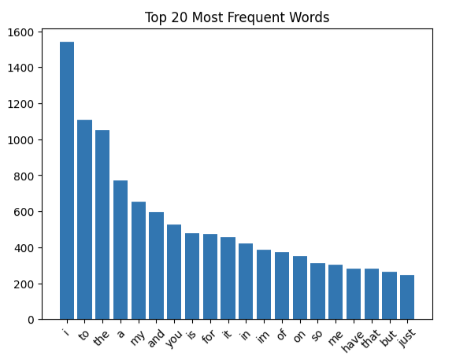
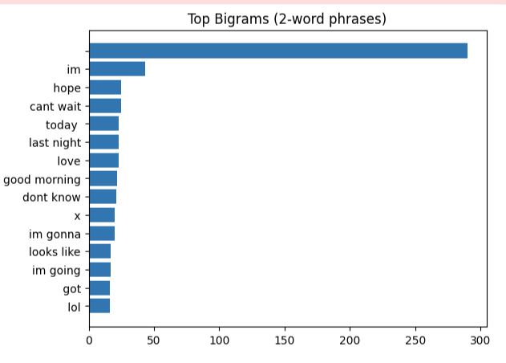
Visualisation Of Data Post Processing

Slide 8
Logistic Regression (LR)
Classification Mechanism
Logistic Regression acts as a linear discriminative model that predicts the probability of a tweet belonging to the positive or negative class based on the frequency of word tokens.
It is particularly effective for large-scale text analysis because it handles high-dimensional, sparse feature vectors with high computational efficiency and clear interpretability.
Pipeline-Based Implementation
The classifier is integrated into a Spark Pipeline, which seamlessly links the tokenizer, stopword remover, and vectorizer stages to the final learning algorithm.
This architecture ensures that all feature engineering transformations are applied identically to both the 1.28 million training records and the held-out test data, preventing data leakage.
Training & Dataset Details
The model was trained on a randomized 80% split of the 1.6 million tweets, representing approximately 1.28 million data points of diverse social media sentiment.
A fixed seed was utilized during the randomSplit process to ensure the reproducibility of the training environment and the consistency of performance metrics across different runs.
Predictive Performance
The model achieved a significant accuracy of 79.9%, proving that a linear approach can effectively capture the underlying sentiment patterns in millions of short-form messages.
Post-training validation on sample phrases showed high precision in distinguishing polarity, correctly identifying sentiments in both enthusiastic reviews and highly negative complaints.

Slide 9
Naïve Bayes Analysis
Heading 1: Probabilistic Mechanism
Naïve Bayes is a probabilistic classifier based on Bayes' Theorem that assumes "naïve" independence between every pair of features (words) in the dataset.
By calculating the conditional probability of each word appearing in a positive versus negative tweet, it determines the most likely sentiment for the entire message.
Heading 2: Implementation Strategy
The system utilized the native Spark MLlib NaiveBayes estimator, integrating it directly into the established feature engineering pipeline.
Using the same pipeline as the baseline model allowed for a direct, controlled comparison of how different mathematical approaches handle identical feature vectors.
Heading 3: Computational Efficiency
This algorithm is exceptionally efficient for high-dimensional text data because it requires a single pass over the 1.6 million records to calculate word frequencies.
The model significantly reduces the CPU overhead and training time compared to more complex iterative classifiers, making it ideal for large-scale social media analysis.
Heading 4: Performance Leader
Naïve Bayes delivered the highest accuracy in this project, reaching 84.9% on the 20% held-out test set.
This performance indicates that the "naïve" independence assumption is highly effective for large-scale sentiment tasks where word presence is a strong indicator of overall emotional tone.

Slide 10
Random Forest Analysis
Ensemble Mechanism
Random Forest is an ensemble learning method that constructs a multitude of decision trees during training to enhance predictive performance.
This specific implementation utilized 20 individual decision trees to aggregate results and reduce overall model variance.
Robustness and Bagging
The model effectively handles non-linear relationships within the data by combining the outputs of multiple base learners.
It utilizes bagging (bootstrap aggregating) to train each tree on a random subset of data, which significantly reduces the risk of overfitting.
Comparative Performance
While inherently robust, the model yielded a lower accuracy of 65.8% compared to the baseline linear and probabilistic models.
The lower performance suggests that tree-based methods may be less effective when processing the high-dimensional, sparse feature vectors typical of large-scale text data.
Evaluation Context
Despite lower accuracy, this approach provides valuable insights into the complexity of the dataset by testing how non-linear models interpret social media sentiment.

Slide 11
Final Performance Summary & Conclusion
Metrics Overview
The project utilized accuracy as the primary metric for all three models to determine the percentage of correctly predicted sentiments across the test set.
Comparative Performance Table
Naïve Bayes: Achieved the highest accuracy at 84.9%
Logistic Regression: Delivered solid baseline performance with an accuracy of 79.9%
Random Forest: While robust, this ensemble method yielded a lower accuracy of 65.8%
Technical Conclusion
The high accuracy of the Naïve Bayes model suggests that probabilistic approaches are highly effective for high-dimensional text data where word presence is a strong sentiment indicator.
The lower performance of the Random Forest model highlights the challenge of using tree-based ensemble methods on sparse feature vectors produced from millions of short-form tweets.

Slide 12
Contribution of Team Members
Overview
This project was carried out collaboratively by Goutam and Abhirup, with an equal contribution of 50% each. The responsibilities were distributed as follows:
Contribution by Goutam
Technical Conclusion
Designed the overall project architecture and workflow.
Set up the Apache Spark environment and handled large-scale data processing.
Implemented data loading and preprocessing steps, including text cleaning and label transformation.
Developed and trained the Logistic Regression model.
Performed model evaluation and accuracy analysis.
Managed model saving and pipeline structuring.

Slide 13
Contribution of Team Members
Overview
This project was carried out collaboratively by Goutam and Abhirup, with an equal contribution of 50% each. The responsibilities were distributed as follows:
Contribution by Abhirup
Technical Conclusion
Implemented feature engineering techniques such as Tokenization, StopWords removal, and CountVectorization..
Developed and trained Naïve Bayes and Random Forest models.
Handled probability vector correction using UDFs..
Performed data visualization, including sentiment distribution and word frequency analysis.
Conducted bigram analysis and insights generation.
Assisted in documentation and report preparation.

